Slide 1

How important is deliberate practice for chess? Re-analysis of a key study
Zach Hambrick, Michigan State University
May 29, 2016
APS Annual Convention
Science of Expertise Symposium
Chicago, Illinois

Slide 2
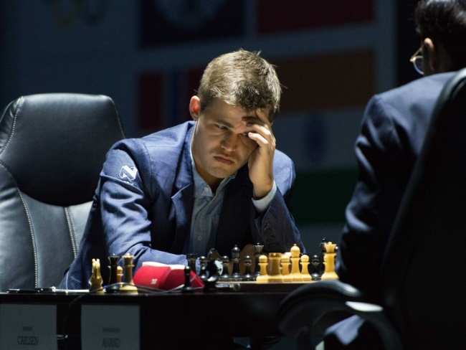
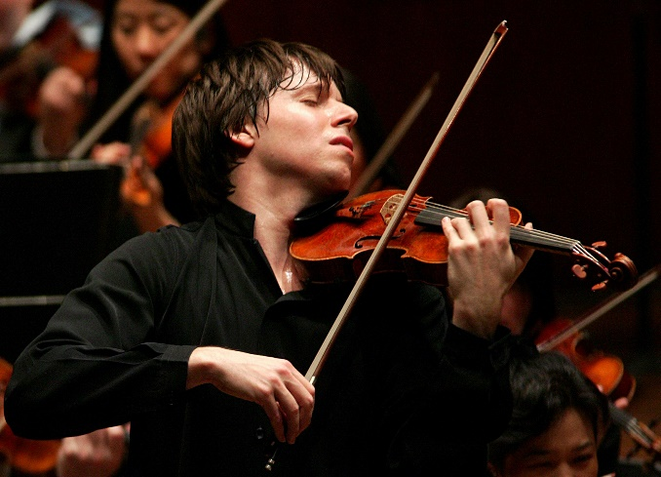
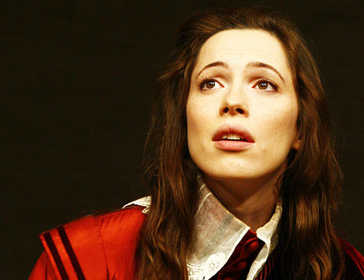
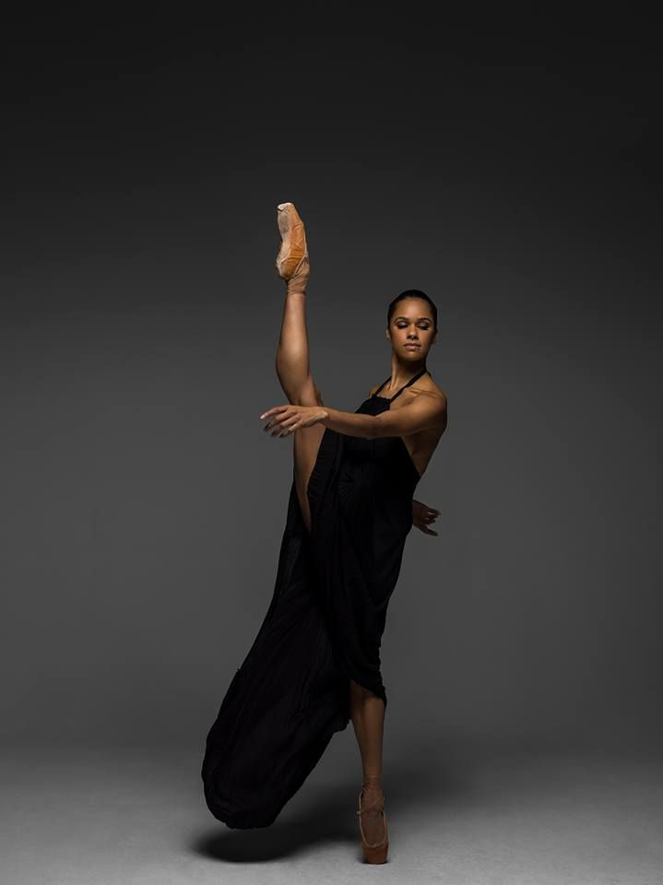
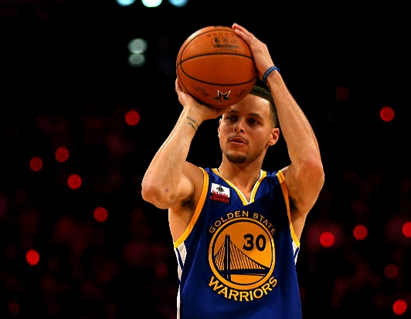

VARIABILITY IN SKILL

Slide 3

VARIABILITY IN SKILL
- Learned moves of chess at 5
- Took up game seriously at 8
- Grandmaster at 13
- FIDE World No. 1 at 19
- Highest rating in history at 24

Slide 4
VARIABILITY IN SKILL
- Learned moves of chess at 5
- Took up game seriously at 8
- Grandmaster at 13
- FIDE World No. 1 at 19
- Highest rating in history at 24
April 2016: World No. 1 in classical, rapid, and blitz chess

Slide 5
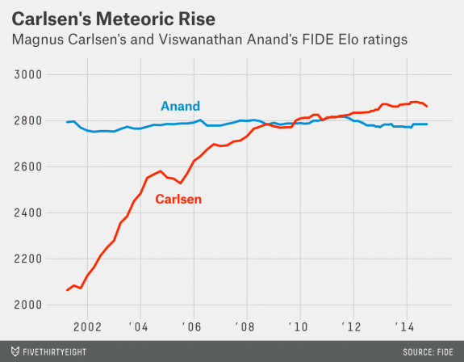
VARIABILITY IN SKILL

Slide 6

THE SCIENCE OF EXPERTISE
?
What factors explain this striking variability?

Slide 7
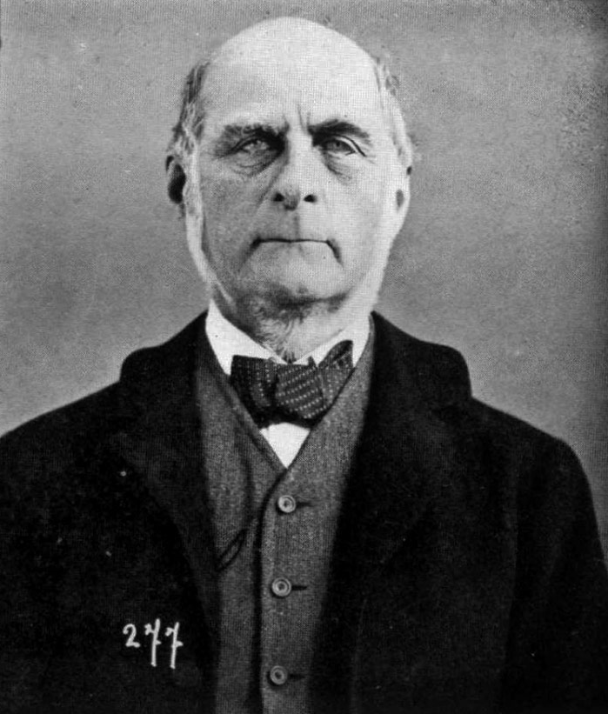
BORN VS. MADE
I HAVE no patience with the hypothesis occasionally expressed, and often implied, especially in tales written to teach children to be good, that babies are born pretty much alike, and that the sole agencies in creating differences between boy and boy, and man and man, are steady application and moral effort.”
- Francis Galton (1869)
“

Slide 8
BORN VS. MADE
[S]ocial hindrances cannot impede men of high ability, from becoming eminent [and] social advantages are incompetent to give that status, to a man of moderate ability.”
- Francis Galton (1869)
“

Slide 9
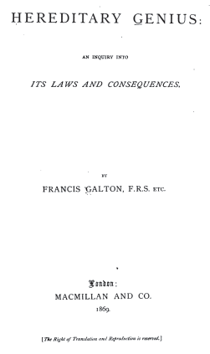
BORN VS. MADE

Slide 10
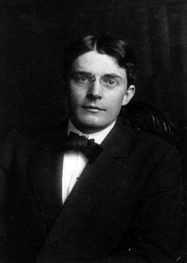
BORN VS. MADE
Give me a dozen healthy infants, well-formed, and my own specified world to bring them up in and I'll guarantee to take any one at random and train him to become any type of specialist I might select - doctor, lawyer, artist, merchant-chief and, yes, even beggar-man and thief, regardless of his talents, penchants, tendencies, abilities, vocations…”
- John Watson (1930)
“

Slide 11
BORN VS. MADE
[P]racticing more intensively than others…is probably the most reasonable explanation we have today not only for success in any line, but even for genius.”
- John Watson (1930)
“

Slide 12

BORN VS. MADE
[I]ndividual differences in ultimate performance can largely be accounted for by differential amounts of past and current levels of practice.”
- Ericsson et al. (1993)
“
K. Anders Ericsson, Florida State U.

Slide 13



BORN VS. MADE
We actually find that with the right kind of training any individual will be able to acquire abilities that were previously viewed as only attainable if you had the right kind of genetic talent.”
- K. Anders Ericsson
Freakonomics Radio, April 27, 2016
“

Slide 14
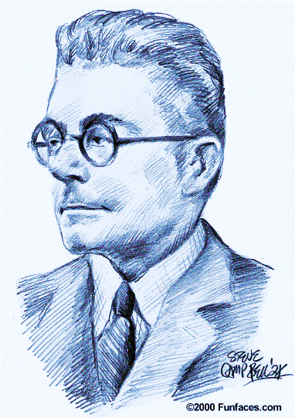
BORN VS. MADE
We actually find that with the right kind of training any individual will be able to acquire abilities that were previously viewed as only attainable if you had the right kind of genetic talent.”
- K. Anders Ericsson
Freakonomics Radio, April 27, 2016
“

Slide 15

BORN VS. MADE
We actually find that with the right kind of training any individual will be able to acquire abilities that were previously viewed as only attainable if you had the right kind of genetic talent.”
- K. Anders Ericsson
Freakonomics Radio, April 27, 2016
“

Slide 16

BORN VS. MADE
“
[U]ntil Ericsson shows cognitive expertise development in a randomly selected group of subjects, including those with
moderate mental retardation, there is no reason to believe that such development can be accomplished. In the absence of such data, over 100 years of intelligence and educational research results suggest that Ericsson's claims should be taken with great reluctance, because they may have highly disappointing results for parents and others who have great hopes, but no data on which to base such hopes.”
- Ackerman (2014), Intelligence
Philip Ackerman, Georgia Tech

Slide 17
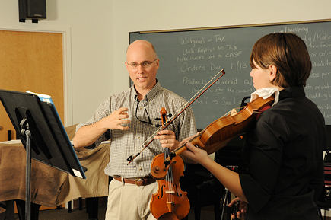
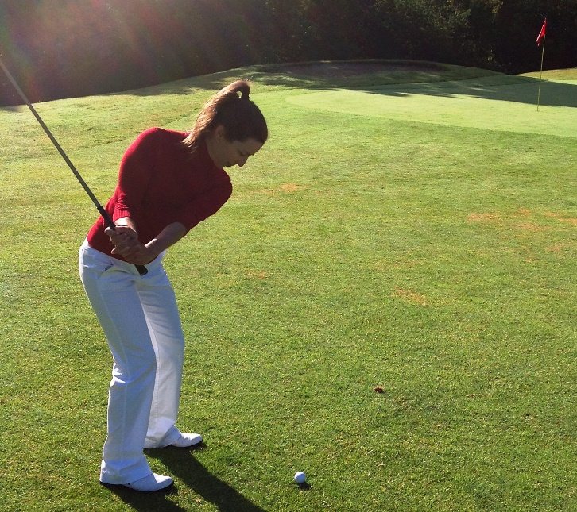
DELIBERATE PRACTICE
Ericsson et al. (1993) proposed the term deliberate practice to refer to those training activities that were designed solely for the purpose of improving individuals' performance by a teacher or the performers themselves.”
- Ericsson (1998)
“

Slide 18
DELIBERATE PRACTICE
Ericsson et al. (1993) proposed the term deliberate practice to refer to those training activities that were designed solely for the purpose of improving individuals' performance by a teacher or the performers themselves.”
- Ericsson (1998)
“

Slide 19
HOW IMPORTANT IS DP?
Research question: Does deliberate practice account for all, nearly all, or at least most of the variance in skill?

Slide 20
HOW IMPORTANT IS DP?
Major inclusion criterion: Measures of one or more activities interpretable as deliberate practice and of performance were collected.

Slide 21
HOW IMPORTANT IS DP?
Chess
6 effect sizes (rs)
(Corrected for unreliability)
Hambrick et al. (2014), Intelligence

Slide 22
HOW IMPORTANT IS DP?
Games
11 effect sizes (rs)
Macnamara, Hambrick, & Oswald (2014), Psychological Science

Slide 23
HOW IMPORTANT IS DP?
Games
After correction for unreliability, assuming reliability = .80 for DP and performance
11 effect sizes (rs)
Macnamara, Hambrick, & Oswald (2014), Psychological Science

Slide 24
HOW IMPORTANT IS DP?
Conclusion of meta-analyses: Deliberate practice is important, but not as important as Ericsson and colleagues have argued.

Slide 25
HOW IMPORTANT IS DP?

Slide 26

HOW IMPORTANT IS DP?

Slide 27
PRESENT STUDY
Research question: How much of the variance in skill does deliberate practice explain in the best research?

Slide 28

PRESENT STUDY
This paper reports the most compelling and detailed evidence for how designed training (deliberate practice) is the crucial factor in developing expert chess performance.”
- Ericsson (2005, p. 237)
“

Slide 29

PRESENT STUDY
Charness et al. (2005) – a model study
 Large sample, with replication sample
 Multiple measures of chess activity
 Objective measure of chess skill (rating)
 Wide and continuous range of chess skill
 Validated method to assess deliberate practice
 Reported correlation matrices for SEM re-analysis
✓
✓
✓
✓
Neil Charness, Florida State Univ.
✓
✓

Slide 30
STRUCTURAL EQUATION MODELING
Multivariate statistical technique that permits analysis of data at level of latent variables…
Latent Variable
Measure A
Measure B
Measure C
e
e
e

Slide 31
VARIABLES USED IN RE-ANALYSES
Study 1
N = 239
No restriction on skill level
M = 2032 (SD = 278)
- Chess skill rating
- Total hours serious study
- Total hours tournament play
- Years private instruction
- Years group instruction
- Age serious involvement
Study 2
N = 180
> 1600 rating
M = 2008 (SD = 253)
- Chess skill rating
- Total hours serious study
- Total hours tournament play
- Years private instruction
- Years group instruction
- Age serious involvement

Slide 32
RE-ANALYSIS OF STUDY 1
Log Total Hrs. Serious Study
.91
Serious Chess Activity
.51
Variance Explained = 50.1%
Log Total Hrs. Tourn. Play
.72
Chess Skill Rating
.40
.15
Years Private Lessons
.85
Chess Instruction
-.34
.61
-.08
Years Group Lessons
-.22
Serious Starting Age
χ²(5) = 13.48, p = .019, CFI = .97, NFI = .96, RMSEA = .09
Listwise N = 200
p > .05

Slide 33
RE-ANALYSIS OF STUDY 2
Log Total Hrs. Serious Study
.91
Serious Chess Activity
.46
Variance Explained = 38.8%
Log Total Hrs. Tourn. Play
.52
Chess Skill Rating
.24
.24
Years Private Lessons
.37
Chess Instruction
-.16
.65
-.07
Years Group Lessons
-.45
Serious Starting Age
χ²(5) = 7.99, p = .16, CFI = .98, NFI = .94, RMSEA = .06
Listwise N = 164
p > .05

Slide 34
SUMMARY
Chess Background
Other

Slide 36
One piece
of a complex
puzzle

Slide 37
ADVANCING THE SCIENCE OF EXPERTISE
  We need to develop multifactorial theories of expertise that take into account as many potentially relevant explanatory constructs as possible.

Slide 38
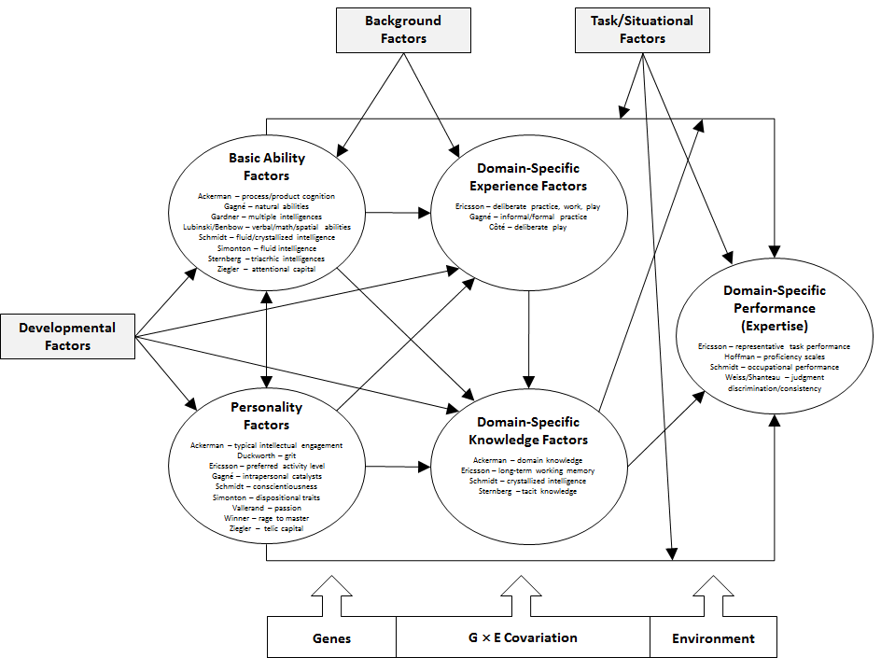
ADVANCING THE SCIENCE OF EXPERTISE
Instantiation of Multifactorial Gene-Environment Interaction Model,
Ullén, Hambrick, & Mosing (2015),
Psychological Bulletin
From Hambrick et al. (2016), Psychology of Learning and Motivation

Slide 39
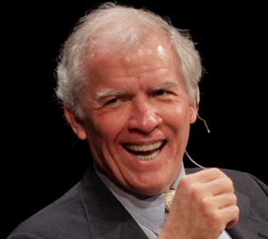
ADVANCING THE SCIENCE OF EXPERTISE
[I]t is extremely likely that environmental factors, including deliberate practice, account for far more variance in performance than does innate capacity in every salient talent domain. Even so, psychology must endeavor to identify all of the significant causal factors behind exceptional performance rather than merely rest content with whatever factor happens to account for the most variance.”
- Dean Simonton (1999)
“

Slide 40
ACKNOWLEDGEMENTS
Brooke Macnamara Case Western Reserve University
Guillermo Campitelli Edith Cowan University
Fredrik Ullén Karolinska Institutet
Miriam Mosing Karolinska Institutet
Erik Altmann Michigan State University
Alex Burgoyne Michigan State University
Fernand Gobet Liverpool University
Giovanni Sala Liverpool University
Betsy Meinz Southern Illinois University
Fred Oswald Rice University

Slide 41
Coming in 2017!
www.scienceofexpertise.com

Slide 42
Thank you!

Slide 43
PROBLEMS WITH ERICSSON’S VIEW
1
Fluid definition of deliberate practice…
Ericsson (2016) criticized us for deviating from his definition of deliberate practice as training designed by teacher.
Problem: In the past, Ericsson explicitly stated that “deliberate practice” (exact term) does NOT need to be designed by a teacher.

Slide 44
PROBLEMS WITH ERICSSON’S VIEW
Ericsson et al. (1993) proposed the term deliberate practice to refer to those training activities that were designed solely for the purpose of improving individuals' performance by a teacher or the performers themselves.”
- Ericsson (1998, p. 84, emphasis added)
Deliberate practice “activities can be designed by external agents, such as teachers or trainers, or by the performers themselves.”
- Keith & Ericsson (2007, p. 136, emphasis added)
“

Slide 45
PROBLEMS WITH ERICSSON’S VIEW
2
Shifting standards for evidence…
Ericsson (2014): claimed that only 1 of 88 studies in Macnamara, Hambrick, and Oswald (2014) meta-analysis meets his criteria for accurately estimating the relationship between deliberate practice and performance.
Problem: Ericsson rejects studies he has previously used to argue for the importance of “deliberate practice” (exact term).

Slide 46
PROBLEMS WITH ERICSSON’S VIEW
Example 1: Duffy, Baluch, & Ericsson (2004)
Ericsson (2015) rejects this study—
one of his own—because there is no record of a teacher/coach supervising all or most of practice, but earlier, he and his colleagues stated:
This finding supports one of the main tenets of Ericsson et al.’s (1993) theory whereby expertise is acquired through a vast number of hours spent engaging in activities purely designed to improve performance, i.e., deliberate
practice.” (p. 243)
- Duffy, Baluch, & Ericsson (2004)
“

Slide 47
PROBLEMS WITH ERICSSON’S VIEW
Example 2: Charness et al. (2005)
Ericsson (2015) rejects this study for same reason as previous example, but earlier, he stated:
“
This paper reports the most compelling and detailed evidence for how designed training (deliberate practice) is the crucial factor in developing expert chess performance.”
- Ericsson (2005, p. 237)

Slide 48
PROBLEMS WITH ERICSSON’S VIEW
Studies that Ericsson has used in past to argue for importance of “deliberate practice” (exact term; his own studies in red), but rejected in his critique of our meta-analysis (Ericsson, 2014):
1) Charness, Tuffiash, Krampe, Reingold, & Vasyukova (2005)
2) de Bruin, Rikers, & Schmidt (2007)
3) Duckworth, Kirby, Tsukayama, Berstein, & Ericsson (2011)
4) Duffy, Baluch, & Ericsson (2004)
5) Ericsson, Krampe, & Tesch-Römer (1993) - Study 1
6) Harris (2008) (dissertation supervised by Ericsson)
7) Helsen, Strakes, & Hodges (1998)
8) Hodges & Starkes (1996)
9) Hodges, Kerr, Starkes, Weir, & Nananidou (2004)
10) Hutchinson, Sachs-Ericsson, & Ericsson (2013)
11) Krampe & Ericsson (1993)
12) Sloboda (1996)
13) Sonnentag & Kleine (2001)
14) Starkes et al. (1996)
15) Tuffiash, Roring, & Ericsson (2007)
16) Ward, Hodges, Williams, & Starkes (2004)
17) Young (1998); Young et al. (2008) (cited in Starkes et al.)

Slide 49

Using studies to argue for a theory, then rejecting those studies…

Slide 50
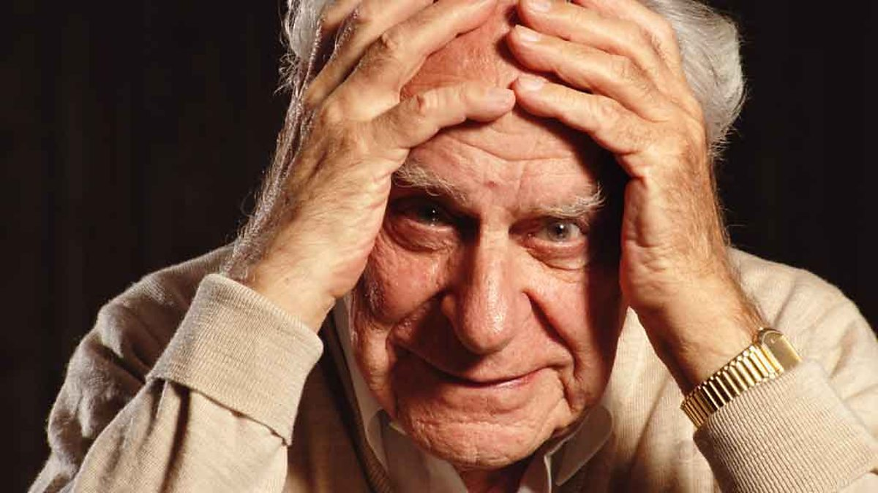
“
In so far as a scientific statement speaks about reality, it must be falsifiable: and in so far as it is not falsifiable, it does not speak about reality.”
- Karl Popper, The Logic of Scientific Discovery

Slide 51
CAVEATS
Ericsson (2006), Figure 38.4
(1) Case for deliberate practice is based
largely on cross-sectional evidence.

Slide 52
CAVEATS
Ericsson (2006), Figure 38.4
Selective attrition: People who are not very
good may drop out.

Slide 53
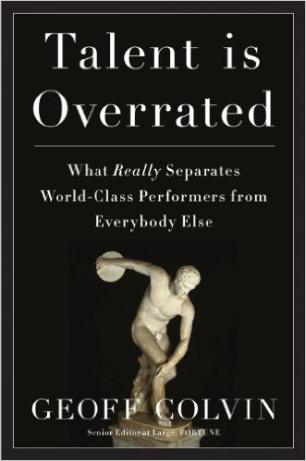
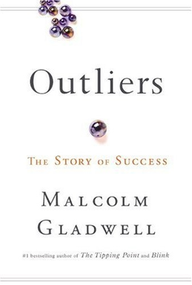
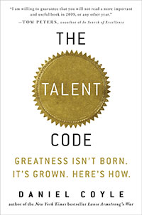
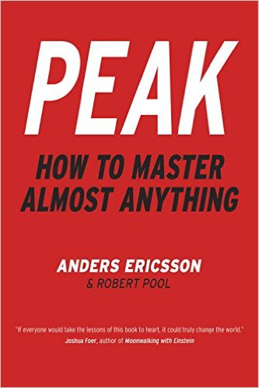
CAVEATS
(2) Case for deliberate practice is based
largely on self-reports of practice.

Slide 54
CAVEATS
Validity of estimates: People may base practice estimates on current level of skill.

Slide 55
CAVEATS
Validity of estimates: Estimates may be influenced by popular(ized) views

Slide 56
Sources for Graphics
http://waterpolo218.deviantart.com/art/no-creativity-346991145
http://article.wn.com/view/2014/11/23/Carlsen_retains_world_chess_title/
http://dancemelody.com/ballet-pictures/rss/feed/gallery/latest
http://images.performgroup.com/di/library/sporting_news/4c/4f/stephen-curry-021415-ftr-gettyjpg_zk4nwx55fa8i1mj6kihzjw880.jpg?t=-1958837941
http://www.joshuabell.com/official-photos/16262
http://www.japantimes.co.jp/life/2012/01/01/people/a-fusion-of-cultures-revealed-in-dance/
http://www.cinematicparadox.com/2011/06/5-reasons-why-i-love-rebecca-hall.html
http://www.chess.com/news/carlsen-v-anand-world-world-championship-coverage-2888
http://fivethirtyeight.com/features/magnus-carlsen-world-chess-championship/?utm_medium=twitter&utm_source=twitterfeed
http://commons.wikimedia.org/wiki/File:Galton_at_Bertillon's_(1893).jpg
http://www.mugu.com/galton/books/hereditary-genius/
http://commons.wikimedia.org/wiki/File:John_Broadus_Watson.JPG
http://www.hsmagazine.net/2012/09/the-challenge-of-creating-music/
http://blog.indezine.com/2013_02_01_archive.html
http://conference2014.talentday.eu/sites/all/files/K_Anders_Ericsson_v_0.jpg?1397769494
https://itunes.apple.com/gb/podcast/freakonomics-radio/id354668519?mt=2
http://education101intrototeaching.pbworks.com/w/page/10077124/Theories%20of%20Education%3A%20%20Behaviorism
http://www.freepik.com/free-photos-vectors/question-mark
http://www.vectortop.com/category/free-psd
http://deltacenter.uiowa.edu/
http://doandroidsdance.com/features/10-trends-we-dont-want-to-see-in-2013/s/uneducated-fans/
http://www.gettyimages.com/detail/news-photo/philosopher-sir-karl-popper-poses-at-his-home-in-croydon-in-news-photo/3449586
http://astore.amazon.co.uk/picbotcom/images/1591842247/280-4412852-1420425
http://penguinrandomhouse.ca/imprints/viking
https://en.m.wikipedia.org/wiki/Outliers_%28book%29
http://thetalentcode.com/2012/03/20/the-real-lessons-of-the-10000-hour-rule/
(sources listed in order of graphic presentation)

